Slide 1
Phase Spectrogram

Slide 2
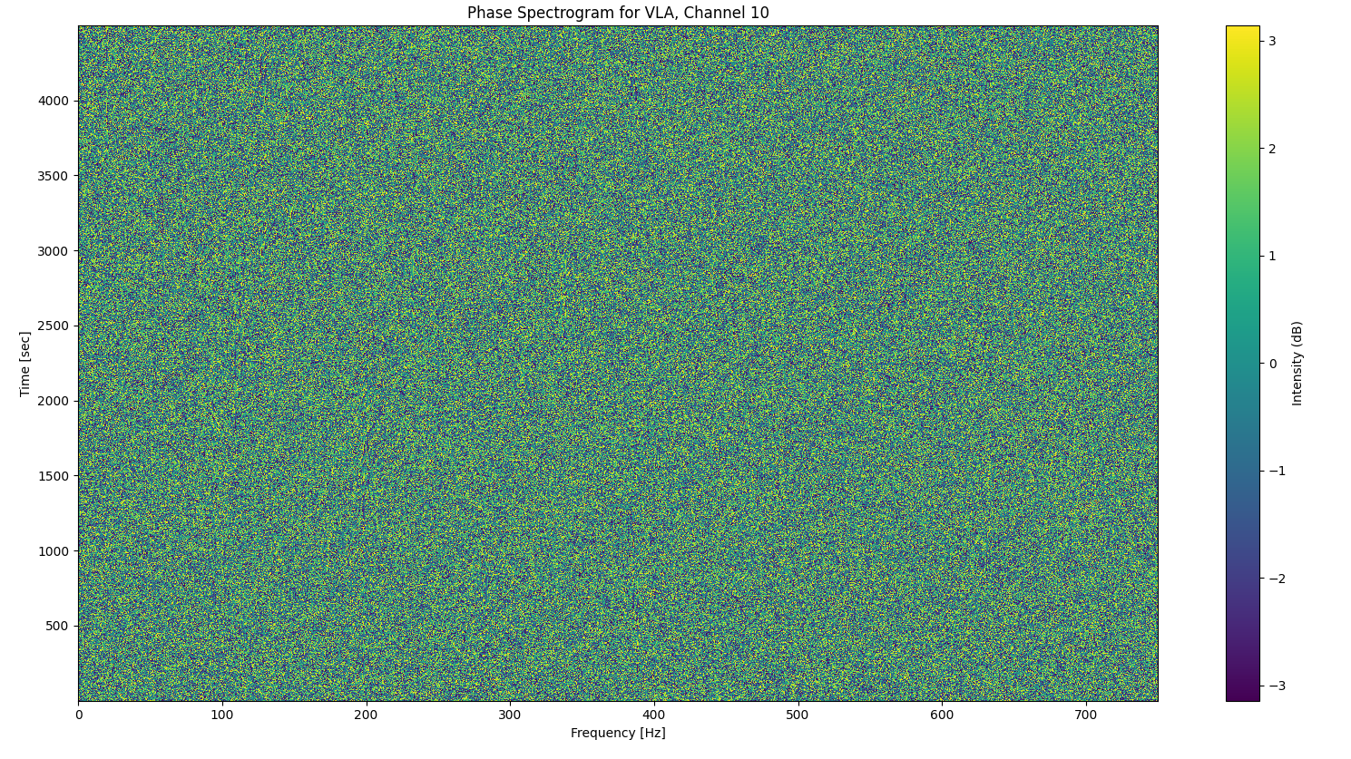

Slide 3
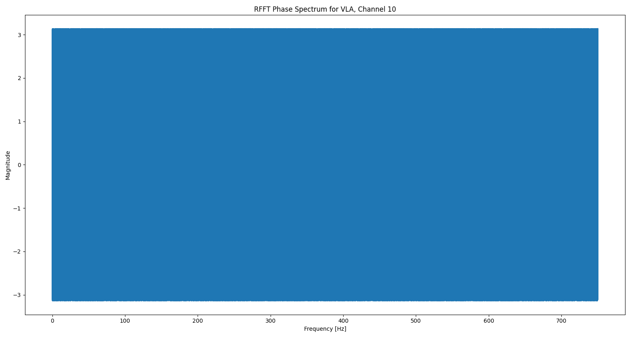
Phase Spectrum

Slide 4
Exploring Algorithmic Methods
Background: Array Signal Processing
Beamforming
Near-Acoustic Holography
Focalization
Minimum Variance Distortionless Response (MVDR)

Slide 5
Cost Functions Used in Deep Learning
Sample Covariance Matrix [SCM]
Generalized Cross Correlation with Phase Transform [GCC-PHAT] (important!)
Cross Correlation

Slide 6
Useful Deep-Learning Methods to Explore
Autoencoders (Variational, Convolutional etc.)
Self-attention and Transformer-based
Convolution Based

Slide 7
Data Collection and Simulation
Iqra‘s Literature Review contains Data Sources
KRAKEN – Generation of Simulated Data

